Slide 1

Artificial Intelligence: From Theory to Practice
A Journey Through Concepts, Algorithms, and Game AI
Presented by: Jannatul Khould Neju
Course: Artificial Intelligence

Slide 2




What is Artificial Intelligence?
Artificial Intelligence (AI) is the science of making machines perform tasks that typically require human intelligence. This field encompasses a wide range of sub-disciplines, from problem-solving to learning from data. Its evolution traces back to early theoretical concepts in the 1950s, leading to significant breakthroughs that now impact various real-world sectors.
"The science of making machines do things that would require intelligence if done by humans." – Marvin Minsky
Healthcare
Gaming
AI assists in diagnostics, drug discovery, and personalized treatment plans.
AI powers intelligent opponents and realistic character behaviors in video games.
Robotics
Automation
AI enables robots to perceive, reason, and act in complex environments.
AI optimizes industrial processes, enhancing efficiency and reducing human error.

Slide 3
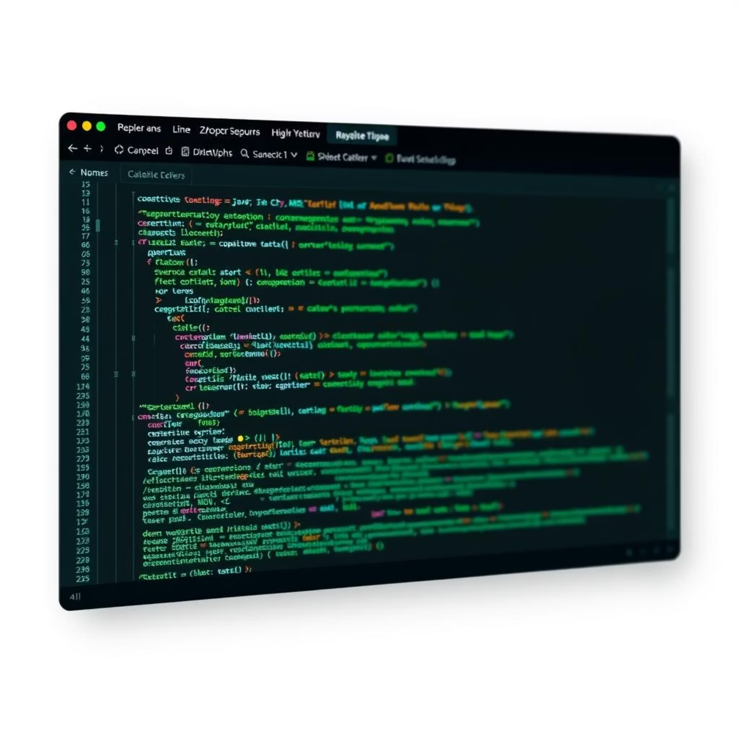
My Journey in AI: Core Concepts and Implementations
This course provided a comprehensive foundation in key AI paradigms. We explored the theoretical underpinnings of intelligent systems and gained practical experience in translating these concepts into functional code. The hands-on approach was crucial for understanding the intricacies of algorithm design and optimization.
Topics Covered
Hands-on Practice
Intelligent Agents: Understanding how autonomous entities perceive and act.
Implemented search and game algorithms in:
Problem-Solving: Techniques for finding optimal solutions in various scenarios.
Python: For rapid prototyping and algorithm testing.
Search Algorithms: Navigating complex state spaces efficiently.
Java: For building more robust and scalable AI systems.
Game-Playing AI: Developing strategies for adversarial environments.
C++: For performance-critical applications, especially in game AI.

Slide 4
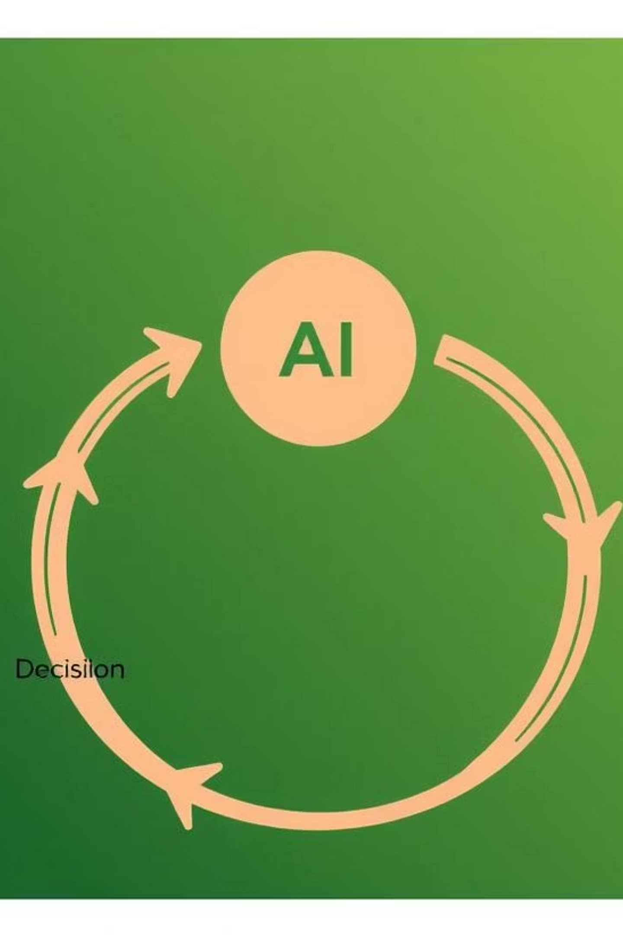
Agents and Their Environments
At the heart of AI are intelligent agents, systems designed to act autonomously in an environment. An agent constantly perceives its surroundings, makes decisions based on these perceptions, and then executes actions, forming a continuous loop. Different types of agents are characterized by their decision-making logic and complexity.
Simple Reflex Agents
1
Act based on current percepts, ignoring history. Example: Vacuum cleaner reacting to dirt.
Goal-Based Agents
2
Consider future actions and their outcomes to achieve specific goals. Example: Pathfinding robot.
Utility-Based Agents
3
Choose actions that maximize their expected utility, considering both goals and preferences. Example: Automated trading system.
Learning Agents
4
Improve their performance over time by learning from experience. Example: AI for self-driving cars.

Slide 5
Navigating Complex Spaces: Uninformed & Informed Search
Search algorithms are fundamental to problem-solving in AI, allowing agents to explore possible states to find a solution. We differentiate between uninformed search, which explores systematically without domain-specific knowledge, and informed search, which uses heuristics to guide the search towards the goal more efficiently.
Uninformed Search
Informed (Heuristic) Search
These algorithms explore the search space without any knowledge of the goal's location, relying solely on the structure of the problem.
These algorithms use heuristic functions to estimate the cost from the current state to the goal, significantly speeding up the search process.
Breadth-First Search (BFS): Explores layer by layer, guaranteeing the shortest path in terms of number of steps.
Best-First Search: Always expands the node that appears to be closest to the goal.
Depth-First Search (DFS): Explores as far as possible along each branch before backtracking.
A* Algorithm: Combines uniform-cost search with greedy search, providing optimal paths.
Iterative Deepening Search (IDS): Combines benefits of BFS and DFS by gradually increasing depth limit.
Greedy Search: Always chooses the path that appears best at the moment, without considering future implications.

Slide 6






Local Search & Optimization
Local search algorithms are used to find optimal or near-optimal solutions in large search spaces, particularly when the exact global optimum is hard to find. These methods iteratively move from one solution to a neighboring one, aiming to improve the objective function. They are crucial for problems like finding the best configuration in games or optimizing complex routes.
Hill Climbing
Simulated Annealing
Beam Search
Greedy approach, always moving towards a better state. Prone to local optima.
Inspired by metallurgy, it allows occasional "bad" moves to escape local optima, enhancing exploration.
Maintains a limited number of "best" candidate solutions at each step, balancing exploration and exploitation.

Slide 7
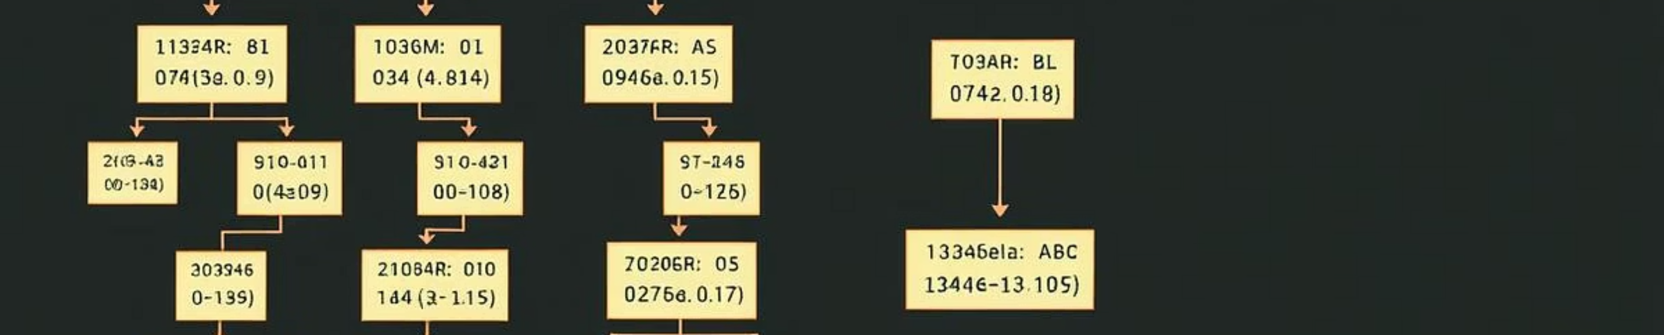
Game AI: Adversarial Search and Strategy
Game AI focuses on developing intelligent agents that can play against human or other AI opponents. Adversarial search algorithms are key to this, especially in perfect information games where both players know the full state of the game. These algorithms aim to predict opponent moves and choose the best response to maximize the agent's chances of winning.
The Minimax algorithm forms the foundation, assuming optimal play from both sides. Alpha-Beta Pruning enhances Minimax by eliminating branches that won't affect the final decision, significantly speeding up computation. Effective evaluation functions are critical for assigning values to non-terminal game states, guiding the search.

Slide 8
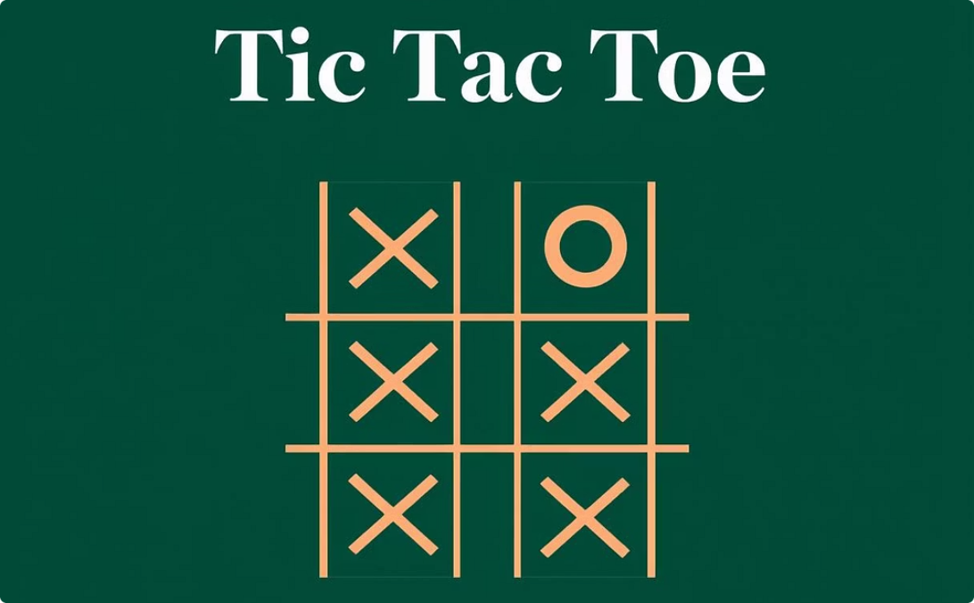
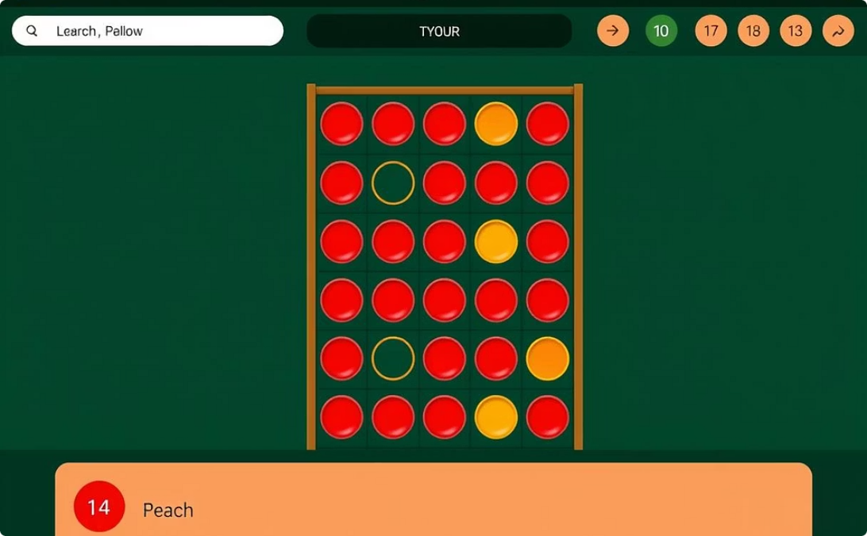

Practical Game AI Implementations
Applying adversarial search concepts, I developed AI for several classic games, showcasing the power of these algorithms in creating challenging opponents. Each project presented unique challenges in balancing computational complexity with strategic depth.
Tic Tac Toe
Connect Four
Chess
Implemented using the Minimax algorithm. The AI plays perfectly, ensuring at least a draw against any opponent.
Utilized Minimax with Alpha-Beta Pruning and custom heuristics for board evaluation, enabling deeper search.
Developed an evaluation function considering piece values, pawn structure, and mobility, combined with pruning logic.

Slide 9

Logic and Knowledge Representation
Knowledge representation is about how information is stored and processed by AI systems to enable reasoning and problem-solving. Logic provides a formal framework for this, allowing AI to make inferences and deductions based on a set of facts and rules. This area is crucial for building expert systems and intelligent agents that can understand and react to complex situations.
Knowledge Base (KB)
A repository of facts and rules about the world, allowing AI to access and process information systematically.
Propositional Logic
A fundamental form of logic where statements are treated as atomic propositions, combined with logical connectives.
Inference and Resolution
Techniques for deriving new conclusions from existing knowledge within the KB, ensuring logical consistency.
Applications in AI
AI Diagnosis: Identifying faults or diseases based on symptoms and knowledge rules.
Rule-Based Systems: AI that makes decisions based on a set of "if-then" rules.
Expert Bots: Systems designed to mimic the decision-making ability of human experts in specific domains.

Slide 10
Conclusion & Future Path in AI
This journey through Artificial Intelligence has provided invaluable insights into the core concepts, algorithms, and practical applications that define the field. From understanding intelligent agents to implementing complex game AI, the foundational knowledge gained forms a strong base for future exploration. The challenges encountered, particularly in debugging and optimization, have further honed problem-solving skills.
Key Takeaways
Challenges Faced
Intelligent Agents are the building blocks of autonomous systems.
Debugging complex algorithms and logic.
Search Algorithms are critical for efficient problem-solving.
Optimizing game logic for performance.
Logic and Knowledge Representation enable AI reasoning.
Fine-tuning search algorithms for efficiency.
Game AI provides a practical playground for adversarial search.
Future Plans
Tools Utilized
My next steps involve diving deeper into:
Python for general AI development.
Machine Learning: Exploring supervised, unsupervised, and reinforcement learning.
Java for robust system implementation.
PyGame for game development.
Deep Learning: Understanding neural networks and their applications.
VS Code for integrated development.
Natural Language Processing (NLP): Developing AI that can understand and interact with human language.

